Slide 1
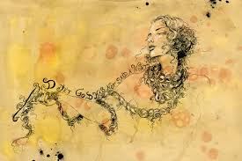
Spoken Language Endorsement
Lesson Objective:
To understand how this unit is assessed and to consider what makes a good speech/presentation.

Slide 2
What's assessed?
Presenting to an audience
Use of Standard English
Use of a range of vocabulary
Responding to questions and feedback
Assessed
Pass / Merit / Distinction (see assessment sheet)
Marked by teacher
A selection of speeches will filmed and sent to EDUQAS.
This unit does not count towards the 9-1 grade of your GCSE but it is a compulsory unit and the grade P, M or D will appear on your certificate.
Lesson Objective: To express information using a range of vocabulary.
Notes:
Thanks to jamiejemiah from TES resources for this slide.

Slide 3
Success Criteria
Go for gold!
Pass | Merit | Distinction
Expresses straightforward ideas, information and feelings; Provides a viewpoint Makes an attempt to meet the needs of the audience through language choices. Makes an attempt to organise and structure the presentation. | Expresses challenging ideas, information and feelings using a range of vocabulary; Provides confident evidence of viewpoint. Achieves the purpose of the presentation through language choices. Organises and structures the presentation clearly and appropriately to meet the needs of the audience. | Expresses sophisticated ideas, information and feelings using a sophisticated repertoire of vocabulary; Presents a detailed and convincing viewpoint Achieves the purpose of the presentation through language choices. Organises and structures the presentation using an effective range of strategies to engage the audience.
Notes:
Students could set a target to focus on for the lesson.

Slide 4
Spoken Language Endorsement
Possible topics/subjects
Read through the hand out and consider the topics.
Shortlist 2 or 3 possible topics.

Slide 5
Topics
1. “What we do says more about us than what we look like.”
2. “We should not eat meat.”
3. “We should not keep animals in zoos.”
4. “People who do not try to live healthy lifestyles should not use the NHS without paying.”
5. “Unemployed people should be made to work.”
6. “I am concerned about... (you choose the topic of concern)”
7. “No one should break the law.”
8. “Social Media is harmful.”
9.“Men should take equal responsibility for looking after the house, caring for children and family.”
10.“Developments in modern science and/or medicine have made the world a better place……”

Slide 6
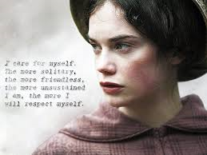
Preparing for your Presentation
Success Criteria Focus: “To use a good quality of standard English and to listen and ask thoughtful questions”
Learning objective: to practise and develop your skills in presenting, listening, thinking and responding.

Slide 7
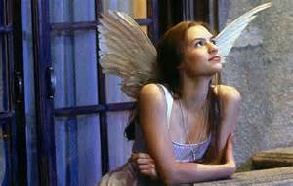
Let’s get started!
Task: Discuss the following questions with your partner. Debate the statements’ importance and relevance in your GCSE study.
How important is it to speak clearly and listen carefully?
Are speaking and listening skills as important as reading and writing skills?
If you never listen carefully, do you really learn?
You have 5
minutes

Slide 8
Thinking
You have 5
minutes
Task: Work in pairs or small groups. Discuss the following things that people have said about speaking. Use the questions next to each one to help you. Be prepared to share your ideas/viewpoints with the class.
Sometimes not speaking says more than all the words in the world.
Do you agree? Do people sometimes talk too much? How important is it to listen?
If young people are silent, it doesn’t mean they don’t have anything to say […] it can be that no-one has ever asked them for their opinions before.
Do you think that young people ‘are silent’? Do adults ask you for your opinions?
Learning objective: to practise and develop your skills in presenting.
Notes:
These are the skills we will practise today!

Slide 9
Present your group’s ideas. Listen to each group and write down a question you would like to ask. Remember, a good question should not require a yes or no response! Start with how, what, why to encourage a more detailed answer! ASK/RESPOND to questions.
Success Criteria Focus: “To use a good quality of standard English and to listen and ask thoughtful questions”
Learning objective: to practise and develop your skills in presenting, listening, thinking and responding.

Slide 10
Preparing for your Presentation
Success Criteria Focus: To organise and structure your presentation to appropriately meet the needs of your audience and to achieve your purpose.
Learning objective: To identify how speakers organise and structure their presentations to meet the needs of the audience and to achieve their purpose.

Slide 11
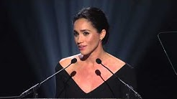
https://www.youtube.com/watch?v=Zkb-zg4JCLk
Watch and listen to the speech and list….
memorable words, techniques and devices used….

Slide 12
Discuss and share….
Work in pairs or small groups.
Discuss and list what techniques and devices the speakers used to engage and interest their audience.
How did they organise and structure their speeches?
In what ways were they successful in achieving their purpose?
Is there anything that you think they need to improve? What? Why? How?

Slide 13
Including your audience
Writing an effective opening.
Today we are launching a campaign called “HeForShe.” I am reaching out to you because I need your help. We want to end gender inequality—and to do that we need everyone to be involved.
This is the first campaign of its kind at the UN: we want to try and galvanize as many men and boys as possible to be advocates for gender equality. And we don’t just want to talk about it, but make sure it is tangible.
By now you should have a good idea of your presentation topic. Spend fifteen minutes writing an effective opening that refers to your audience. Remember to start using a fact or anecdote to make your opening as engaging as possible.
BRONZE: Rhetorical question
Fact
Triplets
Repetition
GOLD: Conditional verbs
Hyperbole
Superlatives
SILVER: Range of pronouns
Opinion
Anecdotes
Lesson Objective: To engage our audience by using a range of strategies.
Notes:
Discuss how this speech is effective. There are copies that you could print out for the group if needed.

